Slide 1





AI chatbot using ChatGPT
Team : Name & Email id Guide: P.Raja, Master Trainer
T.Murugan & tt4384666@gmail.com
Disclaimer: The content is curated for educational purposes only.
Notes:
Slides: Prepare a short slide deck (10-12 slides) summarizing the project objectives, methodology, and key results.

Slide 2
OUTLINE
Abstract of the Project
Problem Statement
Proposed Solution
System Architecture
Embedded Video of Project
Conclusion
Future Scope

Slide 3
Abstract
The AI-Integrated Smart Water Management System represents an innovative approach to addressing global water resource challenges and enhancing disaster preparedness. This system leverages a combination of advanced technologies, including a frontend built with HTML, CSS, and JavaScript, a backend powered by Python and Flask, and MySQL for robust data storage. At its core, the system incorporates machine learning (ML) and artificial intelligence (AI) to deliver predictive analytics and decision support.

Slide 4
Problem Statement
Water scarcity and ineffective water management pose significant challenges to communities and ecosystems around the world.
Inefficient Resource Allocation.
Lack of Real-Time Monitoring.
Inadequate Disaster Preparedness

Slide 5
Proposed Solution
The AI-Integrated Smart Water Management System is designed to address the critical challenges in water resource management and disaster preparedness through the integration of modern technologies. This solution combines real-time data monitoring, machine learning-driven predictive analytics, and automated decision support to enhance the efficiency and responsiveness of water management practices.

Slide 6
System Architecture
The AI-Integrated Smart Water Management System architecture is designed to facilitate efficient data collection, processing, analysis, and user interaction.
Data Collection Layer.
Data Processing Layer.
3. AI and Machine Learning Layer.
User Interface Layer.
Alert and Notification System.

Slide 7
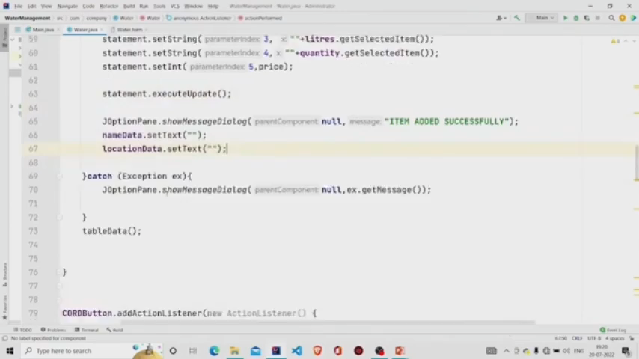
Video of Project Demo

Slide 8
Future Scope

Slide 9
Conclusion
The AI-Integrated Smart Water Management System is a transformative solution designed to address the growing challenges of water resource management and disaster preparedness. By leveraging advanced technologies such as machine learning, artificial intelligence, and IoT, this system provides a comprehensive approach to monitoring, analyzing, and optimizing water usage.It enables real-time insights, predictive analytics, and automated decision-making, ensuring more efficient resource utilization and reducing the risk of water-related disasters. With its scalable architecture and user-friendly interface, the system can be adapted for various applications, including urban planning, agriculture, and industrial operations.As water scarcity and climate change become more pressing global issues, integrating intelligent solutions like this is not just an innovation but a necessity. The AI-Integrated Smart Water Management System offers a practical, future-ready framework for sustainable water resource management and disaster resilience.

Slide 10
Thank you!
Notes:
thank you very much for joining this PPT, keep learning.
10

